Slide 1
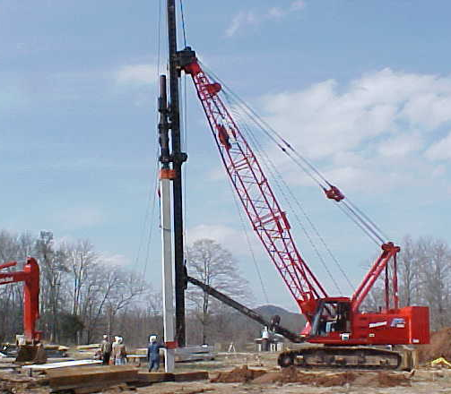
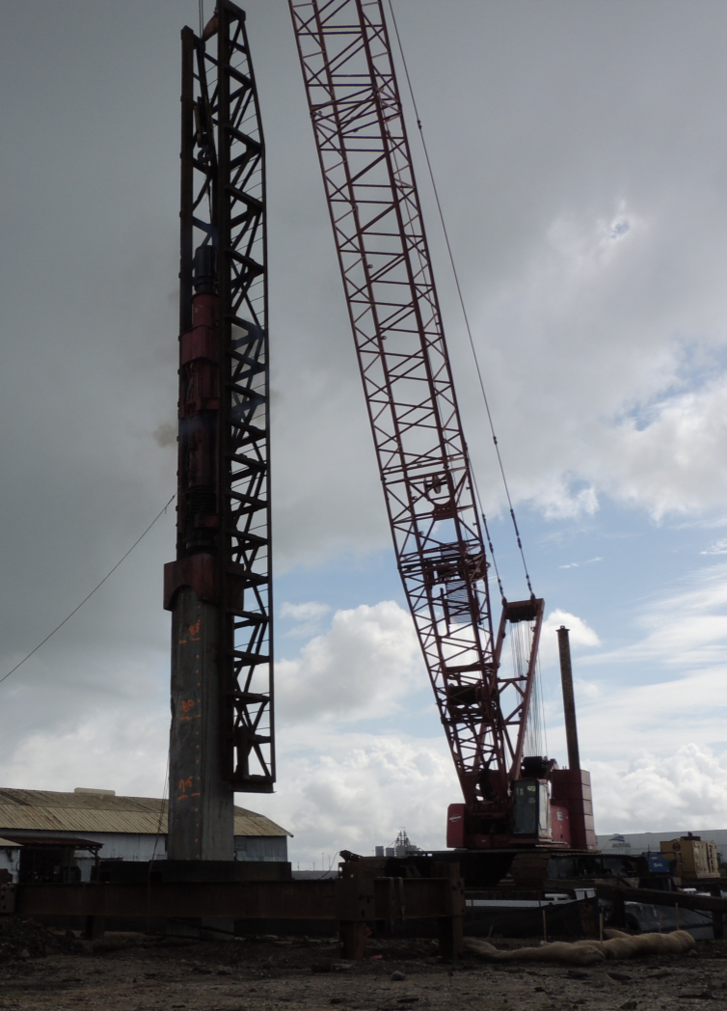

47th STGEC – Biloxi, MS – Nov. 10, 2016
iCAP Pile Testing
Investigation of Signal Matching Software iCAP on Driven Piles in Alabama
Eric Steward, Ph.D., P.E.
Assistant Professor
Department of Civil, Coastal, and Environmental Engineering
University of South Alabama
Ronald Jones
Graduate Student

Slide 2


47th STGEC – Biloxi, MS – Nov. 10, 2016
Pile Testing
“A DRIVEN PILE IS A TESTED PILE!”
Verification of design during installation
Larger projects will install test piles at various locations
Smaller projects will verify production piles during installation
Software enhances the determination of pile resistance during driving and later
University of South Alabama - Dept. of Civil, Coastal, and Enviro. Engineering

Slide 3
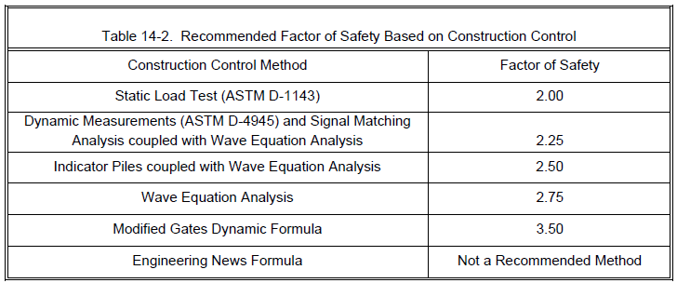
47th STGEC – Biloxi, MS – Nov. 10, 2016
Pile Testing
“A DRIVEN PILE IS A TESTED PILE!”
University of South Alabama - Dept. of Civil, Coastal, and Enviro. Engineering

Slide 4
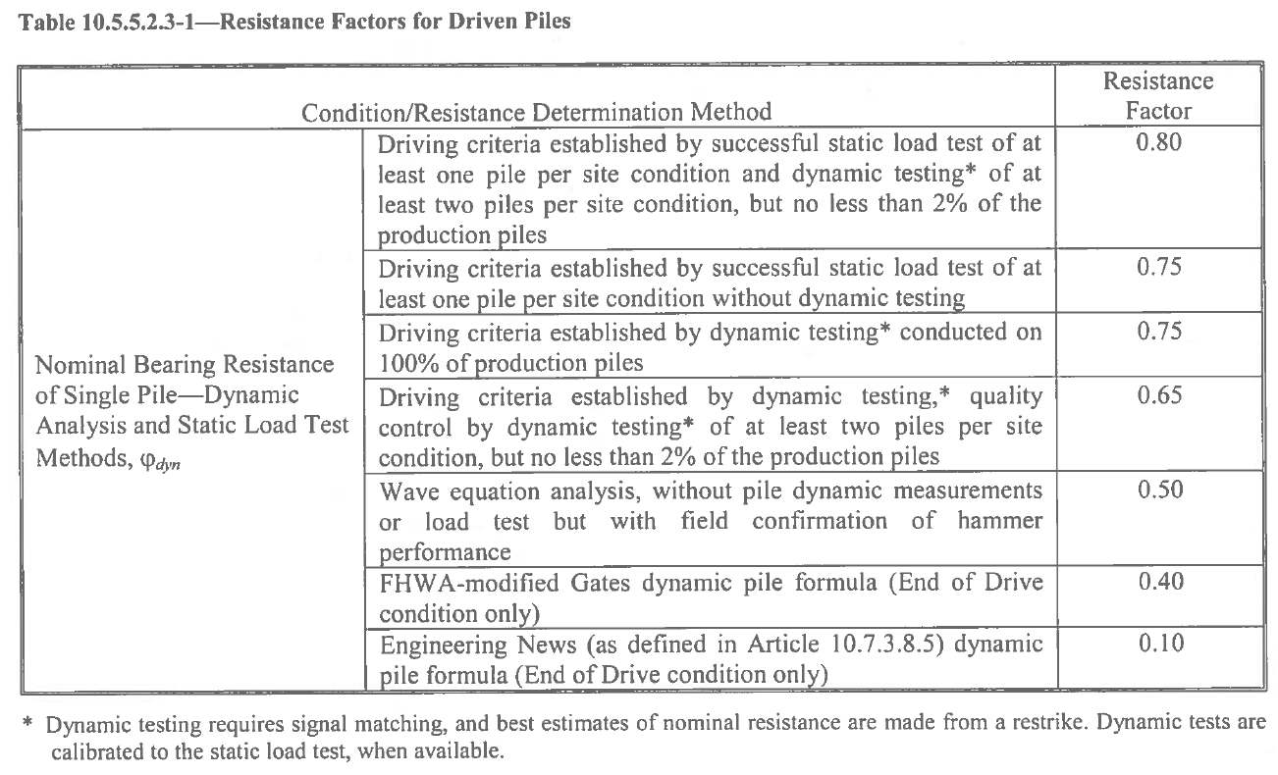
47th STGEC – Biloxi, MS – Nov. 10, 2016
Pile Testing
“A DRIVEN PILE IS A TESTED PILE!”
University of South Alabama - Dept. of Civil, Coastal, and Enviro. Engineering

Slide 5
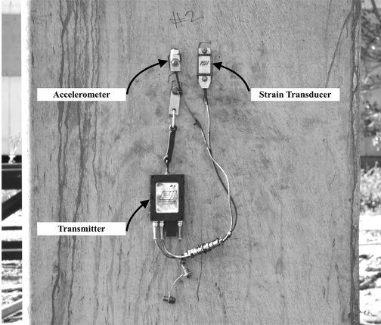
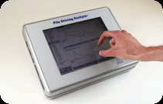
Dynamic Pile Testing
47th STGEC – Biloxi, MS – Nov. 10, 2016
Pile Testing
Estimates static resistance
Estimates internal pile stresses
Verifies pile integrity
University of South Alabama - Dept. of Civil, Coastal, and Enviro. Engineering

Slide 6
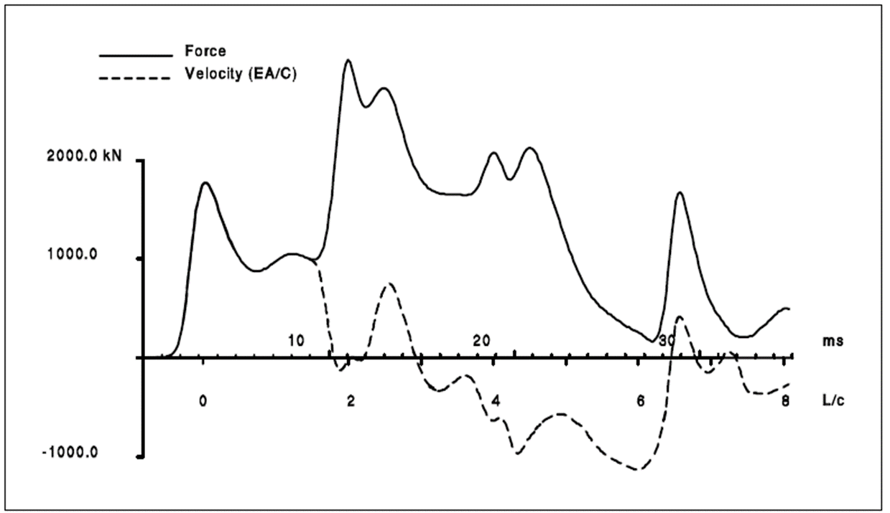
PDA results: Case Method
47th STGEC – Biloxi, MS – Nov. 10, 2016
Pile Testing
Uses Case method equations
Provides immediate pile resistances (RX7 Total Resistance)
Assumed soil damping values (J)
University of South Alabama - Dept. of Civil, Coastal, and Enviro. Engineering

Slide 7
Dynamic Pile Testing – Signal Matching Software
47th STGEC – Biloxi, MS – Nov. 10, 2016
Pile Testing
CAPWAP® is an iterative process to develop soil/pile interaction model
  Provides accurate toe and shaft resistances
  Provides load/displacement and iteratively determine the damping factor (J)
  Claims to be as accurate as Static Load Testing
  Requires trained, experienced personnel
  Non-unique results
  Time-consuming
University of South Alabama - Dept. of Civil, Coastal, and Enviro. Engineering

Slide 8
Dynamic Pile Testing – Signal Matching Software
47th STGEC – Biloxi, MS – Nov. 10, 2016
Pile Testing
CAPWAP® is an iterative process to develop soil/pile interaction model
  Provides accurate toe and shaft resistances
  Provides load/displacement and iteratively determine the damping factor (J)
  Claims to be as accurate as Static Load Testing
  Requires trained, experienced personnel
  Non-unique results
  Time-consuming
University of South Alabama - Dept. of Civil, Coastal, and Enviro. Engineering

Slide 9
Dynamic Pile Testing – Signal Matching Software
47th STGEC – Biloxi, MS – Nov. 10, 2016
Pile Testing
iCAP® is an automatic Signal Matching Program within the PDA
  Provides accurate toe and shaft resistances
  Provides load/displacement and iteratively determine the damping factor (J)
  Claims to be as accurate as CAPWAP???
  Requires trained, experienced personnel
  Non-unique results
  Time-consuming
University of South Alabama - Dept. of Civil, Coastal, and Enviro. Engineering

Slide 10
Dynamic Pile Testing – Signal Matching Software
47th STGEC – Biloxi, MS – Nov. 10, 2016
Pile Testing
iCAP® is an automatic Signal Matching Program within the PDA
  Provides accurate toe and shaft resistances
  Provides load/displacement and iteratively determine the damping factor (J)
  Claims to be as accurate as CAPWAP???
  Requires trained, experienced personnel
    Performed by the PDA Operator
  Non-unique results
  Time-consuming
University of South Alabama - Dept. of Civil, Coastal, and Enviro. Engineering

Slide 11
Dynamic Pile Testing – Signal Matching Software
47th STGEC – Biloxi, MS – Nov. 10, 2016
Pile Testing
iCAP® is an automatic Signal Matching Program within the PDA
  Provides accurate toe and shaft resistances
  Provides load/displacement and iteratively determine the damping factor (J)
  Claims to be as accurate as CAPWAP???
  Requires trained, experienced personnel
    Performed by the PDA Operator
  Non-unique results
    Program performs process, so one solution
  Time-consuming
University of South Alabama - Dept. of Civil, Coastal, and Enviro. Engineering

Slide 12
Dynamic Pile Testing – Signal Matching Software
47th STGEC – Biloxi, MS – Nov. 10, 2016
Pile Testing
iCAP® is an automatic Signal Matching Program within the PDA
  Provides accurate toe and shaft resistances
  Provides load/displacement and iteratively determine the damping factor (J)
  Claims to be as accurate as CAPWAP???
  Requires trained, experienced personnel
    Performed by the PDA Operator
  Non-unique results
    Program performs process, so one solution
  Time-consuming
    Instantaneous results in the field
University of South Alabama - Dept. of Civil, Coastal, and Enviro. Engineering

Slide 13
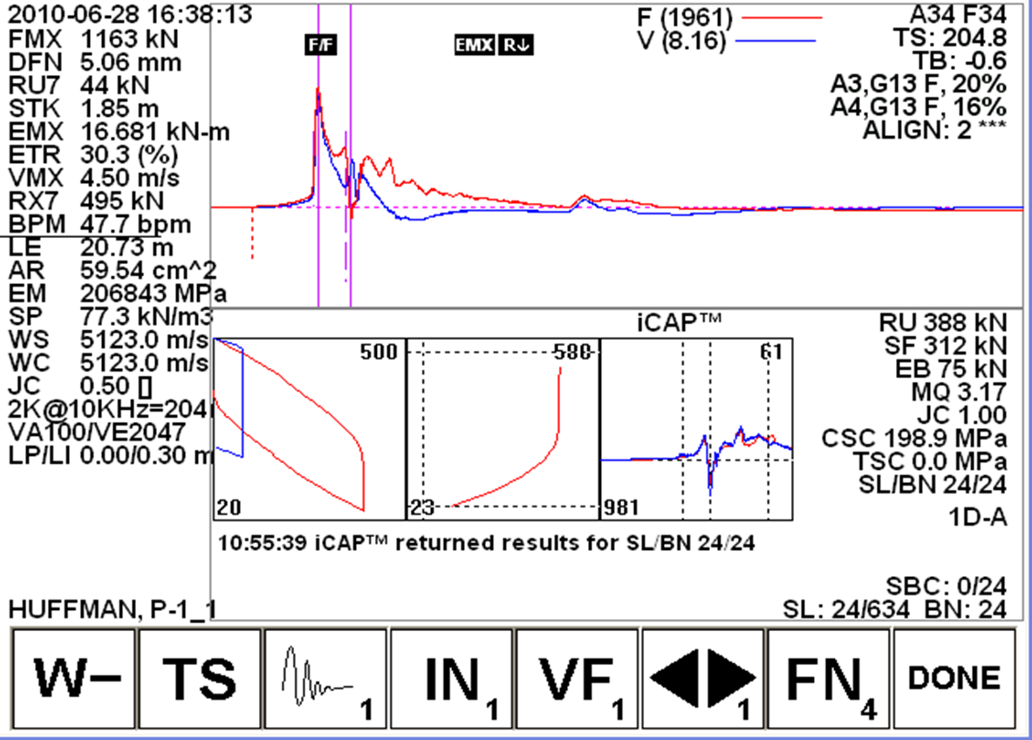
iCAP– Signal Matching Software
47th STGEC – Biloxi, MS – Nov. 10, 2016
Pile Testing
iCAP analysis requires high quality data:
No clipping of signals
Good proportionality
Good agreement between acceleration traces
Moderate bending
No indicated pile damage
- F. Rausche at PDI
University of South Alabama - Dept. of Civil, Coastal, and Enviro. Engineering

Slide 14
45th STGEC - Mobile, AL – Oct. 29, 2014
47th STGEC – Biloxi, MS – Nov. 10, 2016
ALDOT Project
AL DOT Research Objectives
Develop a statewide database for pile test data
Analyze and Evaluate pile setup in Alabama
Develop resistance factors for design of piles in setup prone soils
Provide recommendations to utilize setup in design of future pile projects throughout the state
  Provide information regarding LRFD resistance factors
  Implement preliminary soil testing regime for design
University of South Alabama, Department of Civil Engineering
University of South Alabama - Dept. of Civil, Coastal, and Enviro. Engineering

Slide 15
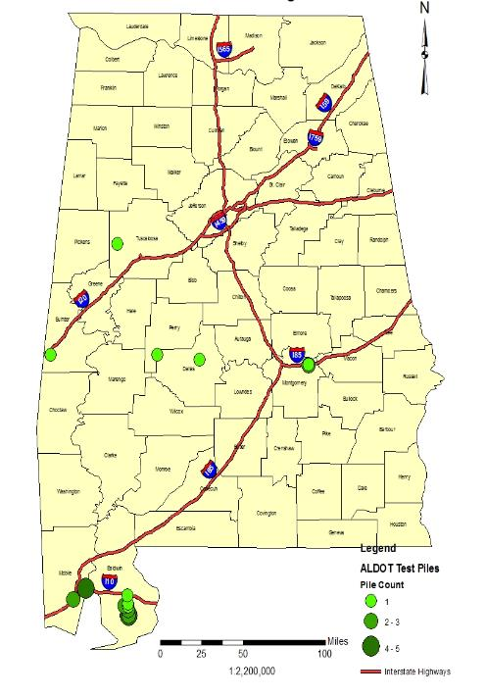

Data Collection
Pile Driving Test Data GIS Map
Collected all pile load tests from 2009 – 2014
  PDA Data (27)
  19 Clayey Sand
    All produced setup effects
  8 Silt or silty sand
    7 slightly relaxed

Slide 16
45th STGEC - Mobile, AL – Oct. 29, 2014
47th STGEC – Biloxi, MS – Nov. 10, 2016
Pile iCAP Analysis
iCAP Data Accuracy
University of South Alabama, Department of Civil Engineering
University of South Alabama - Dept. of Civil, Coastal, and Enviro. Engineering

Slide 17
45th STGEC - Mobile, AL – Oct. 29, 2014
47th STGEC – Biloxi, MS – Nov. 10, 2016
Pile iCAP Analysis
iCAP Data Accuracy
University of South Alabama, Department of Civil Engineering
University of South Alabama - Dept. of Civil, Coastal, and Enviro. Engineering

Slide 18
45th STGEC - Mobile, AL – Oct. 29, 2014
47th STGEC – Biloxi, MS – Nov. 10, 2016
Pile iCAP Analysis
iCAP Data Accuracy
University of South Alabama, Department of Civil Engineering
University of South Alabama - Dept. of Civil, Coastal, and Enviro. Engineering

Slide 19
45th STGEC - Mobile, AL – Oct. 29, 2014
47th STGEC – Biloxi, MS – Nov. 10, 2016
Pile iCAP Analysis
iCAP Data Accuracy
University of South Alabama, Department of Civil Engineering
University of South Alabama - Dept. of Civil, Coastal, and Enviro. Engineering

Slide 20
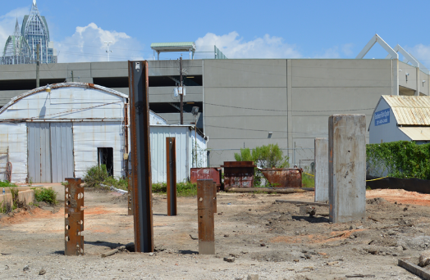
Project Location
45th STGEC - Mobile, AL – Oct. 29, 2014
47th STGEC – Biloxi, MS – Nov. 10, 2016
Pile Tests in AL
University of South Alabama, Department of Civil Engineering
University of South Alabama - Dept. of Civil, Coastal, and Enviro. Engineering

Slide 21

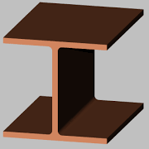
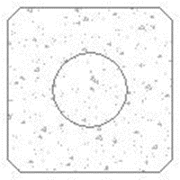
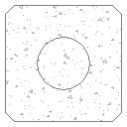
Pile Setup Comparison Mobile River, AL
HP 12 x 53
HP 14 x 117
PC 24” Sq.
PC 36” Sq.
10
30
50
Medium to Dense Sand
70
90
Clay
110
EOD SSR
EOD Toe
EOD Total
80 k
72 k
152 k*
112 k
44 k
156 k
241 k
323 k
564 k
617 k
222 k
839 k

Slide 22
45th STGEC - Mobile, AL – Oct. 29, 2014
47th STGEC – Biloxi, MS – Nov. 10, 2016
Pile Testing
Comparing iCAP Results with SLT
ε = 9.9%
ε = 5.7%
ε = 4.7%
University of South Alabama, Department of Civil Engineering
University of South Alabama - Dept. of Civil, Coastal, and Enviro. Engineering

Slide 23
45th STGEC - Mobile, AL – Oct. 29, 2014
47th STGEC – Biloxi, MS – Nov. 10, 2016
Pile iCAP Testing
iCAP Testing Conclusions
iCAP is a Signal Matching software
  Requires high quality data
  Acceptable for AASHTO Bridge Design
  Instant pile resistance results
Comparison to CAPWAP is very good
More data is always needed
University of South Alabama, Department of Civil Engineering
University of South Alabama - Dept. of Civil, Coastal, and Enviro. Engineering

Slide 24



45th STGEC - Mobile, AL – Oct. 29, 2014
47th STGEC – Biloxi, MS – Nov. 10, 2016
Pile Research
Current project evaluating the design process compared to static load tests
Enhancing LRFD resistance factors
Approved project to develop pile test database
Develop regional LRFD resistance factors
NTP expected any day
University of South Alabama, Department of Civil Engineering
University of South Alabama - Dept. of Civil, Coastal, and Enviro. Engineering

Slide 25
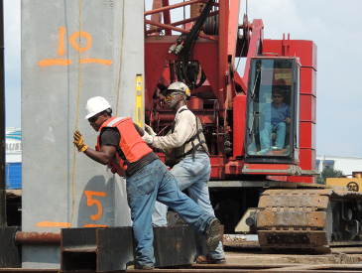

45th STGEC - Mobile, AL – Oct. 29, 2014
47th STGEC – Biloxi, MS – Nov. 10, 2016
Shelby Hall - USA
Questions
Comments
Suggestions
Thank you Alabama Department of Transportation
University of South Alabama, Department of Civil Engineering
University of South Alabama - Dept. of Civil, Coastal, and Enviro. Engineering

